Slide 1


TTI Summit 2020
NYC

Slide 2
Token Taxonomy Workshop: Goals
Complete a full workshop lifecycle in order to fully understand the fundamentals of what the TTF aims to accomplish.
If this is your first time doing a token taxonomy workshop, its more important to experience a full workshop cycle and add a new token definition template then it is to get stuck attempting to identifying/adding a new behavior artifact and/or innovative idea. Once you have a clear understanding of the taxonomy, we encourage innovation!
We also understand that a token definition maybe proprietary. For this workshop, we encourage you to identify an asset which is non-proprietary for the sake of making it through the workshop cycle and experiencing the development of a token definition template. (example: a pen)
The token taxonomy enables business professionals to begin participating in the TTI.
Technology focused professionals should understand how to workshop in order to acquire a non-technical perspective on tokenization.
The workshop is not about implementation and needs to remain agnostic from any implementation.

Slide 3

Taxonomy Workshop: Tasks
Tasks Overview:
High Level Business definition of the targeted token to apply the taxonomy
Decompose the token
Identify base token type and additional non-behavioral properties
Identify taxonomy behaviors already defined that will be included
Describe a behavior that has no match already defined in the taxonomy framework
Create a taxonomy artifact for any new behaviors found and repeat
Complete the token definition by creating an artifact for it.
Submit for review to be included in the framework.

Slide 4
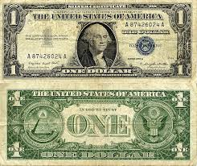
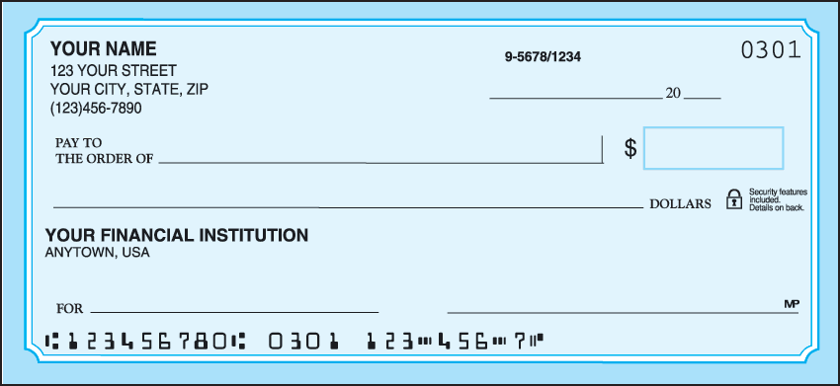

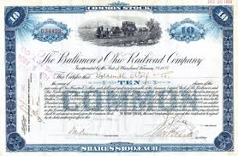
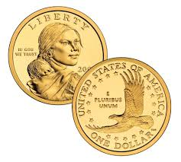
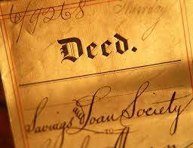
Taxonomy Workshop: Asset Ideation
What types of assets do you work with on a daily basis? How would you define it? Think of an example of how you would use it in business and what I can be compared to?

Slide 5
Taxonomy Workshop: Define The Token Base
If we were to pretend the asset is something we buy at a store brand new, its fair to assume that it doesn’t matter which one you chose off the shelf.
This concept of a product being interchangeable is what the Taxonomy refers to as Fungible. Although some assets are only interchangeable with exact same assets because they are unique.
Likewise, a product or asset which is not interchangeable is considered Non-Fungible.
Can the asset be divided, or is it something that remains whole? Money is divisible where as a document remains whole.
Is the asset something that is one of a kind, such as a Gemstone or an I.D?

Slide 6
Taxonomy Workshop: Discovering Behaviors
How do you typically interact with the asset?
Can others interact with it?
Who maintains the assets ownership?
How do you or others identify it?
Is there is an element of risk management involved?
Is it unique?
Does the asset need to be created on demand or is the asset ever taken out of supply because it transforms?
While going through the list of Behaviors, try starting with the Analogies and move to the Examples before going into the Description.

Slide 7
Taxonomy Workshop: Grouping Behaviors
The idea of grouping behaviors can be a bit tricky when analyzing the Taxonomy for the first time. In fact, at the present time there is only one identified Behavior Group called Supply Control.
The idea of dependencies applies directly to this concept just as they do when managing projects. In parallel, the behaviors, once grouped, will offer one business function that you are likely familiar with.
Do any of your assets behaviors rely on one another in order for their functionality to exist?
If so try providing a business example which offers a description of how they align as one function.

Slide 8
Taxonomy Workshop: Property Sets
Does your asset require the need to store any meta data (ex. SKU or an identifier) and/or storage of a File?
The taxonomy refers to these as Property Sets.

Slide 9
Taxonomy Workshop: The Token Formula
The Token Formula is a combination of the Token Base, the Behaviors, potential Behavior Groups, and Property Sets.
Upon finalizing the formula you are ready to compare and contrast other token formulas and classify the token using your definition. Keep in mind that the definition is comprised of a business description, example and an analogy (an alias is helpful).

Slide 10
Taxonomy Workshop: Classifying The Asset
How would you normally classify something?
A red apple is a fruit. If you were to classify it, you would compare it against other apples and classify it as a Red Apple. Making red apples relative to other red apples.
When we classify something its important to understand that a class represents a supply of assets which are considered the same due to their composition (ex. the description and formula).

Slide 11
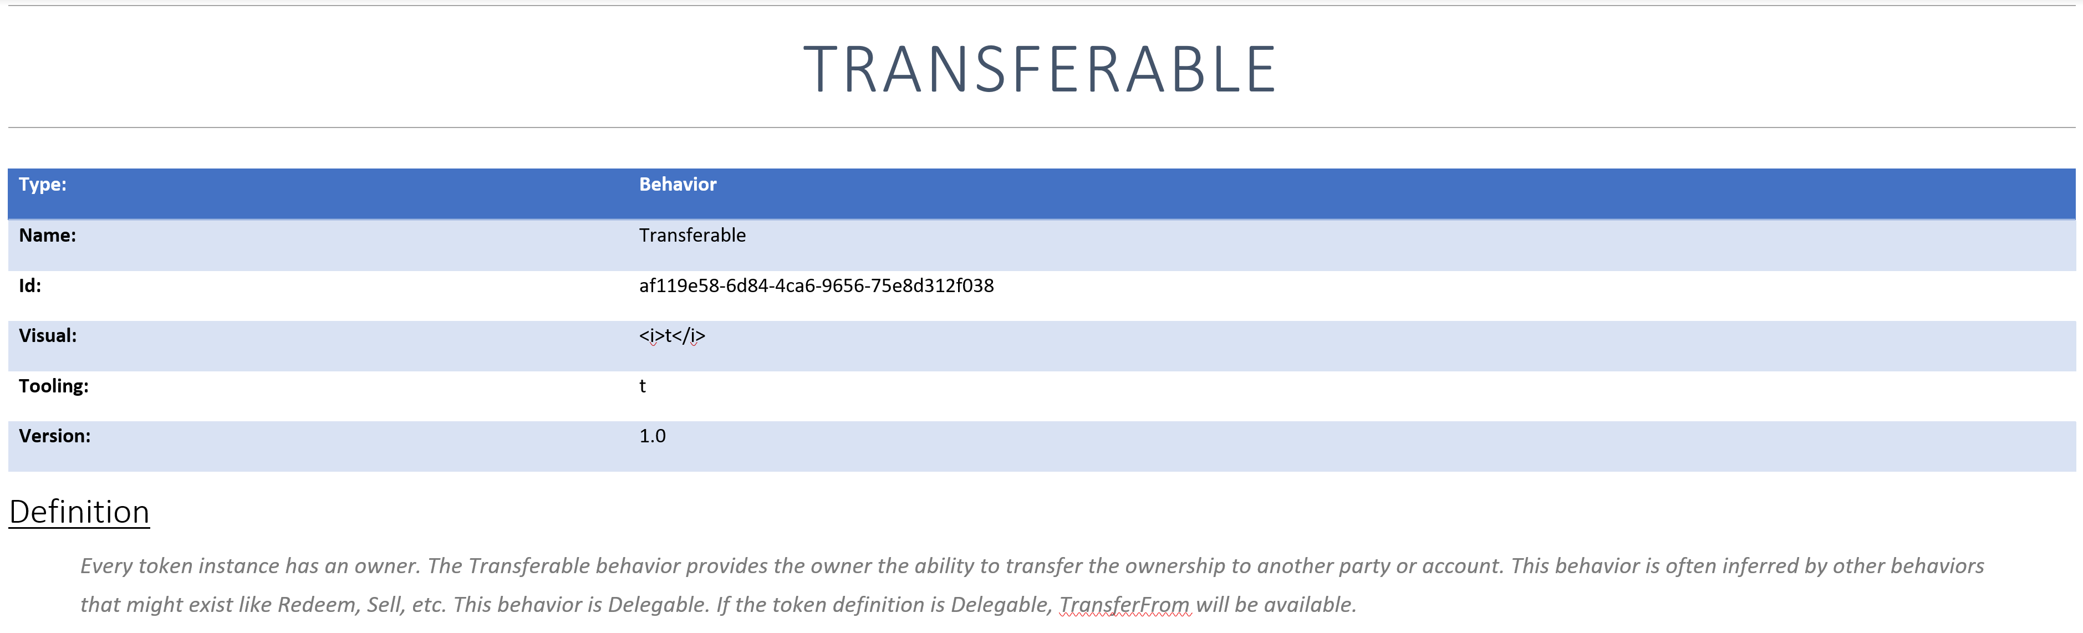
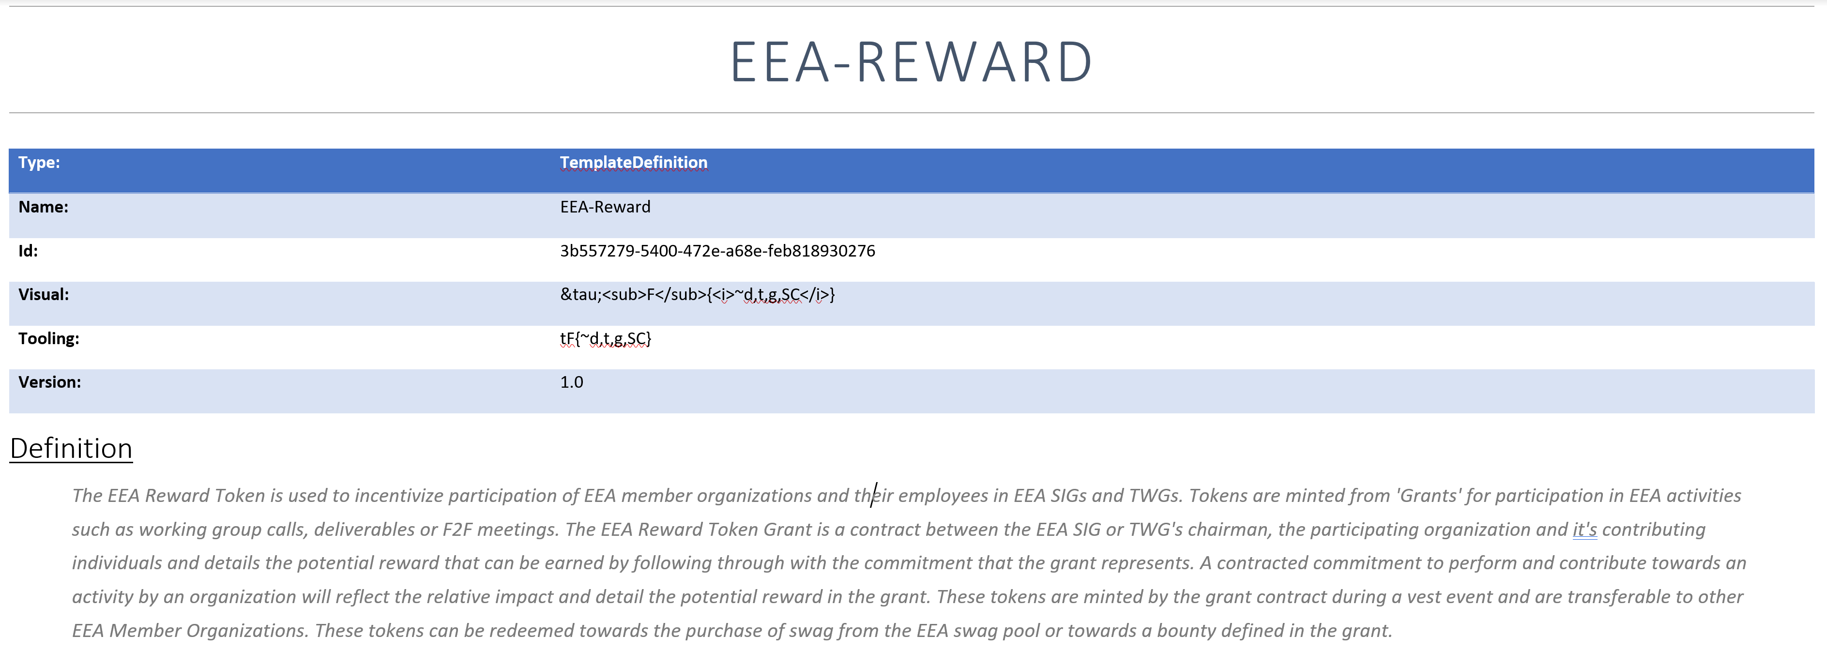
Taxonomy Workshop: Outputs
The Outputs section of the Workshop is where businesses can begin seeing the benefits of the Token Taxonomy Initiative.
All artifacts (Token Base Files, Token Behavior Files, & Token Template Files) have unique identifiers associated to each individual file. This is how the ingredients are sewn together. This way when businesses would like to reuse the same template, it is standardized and defined the same way.

Slide 12

Taxonomy Workshop: Outputs & Tooling

